Slide 1
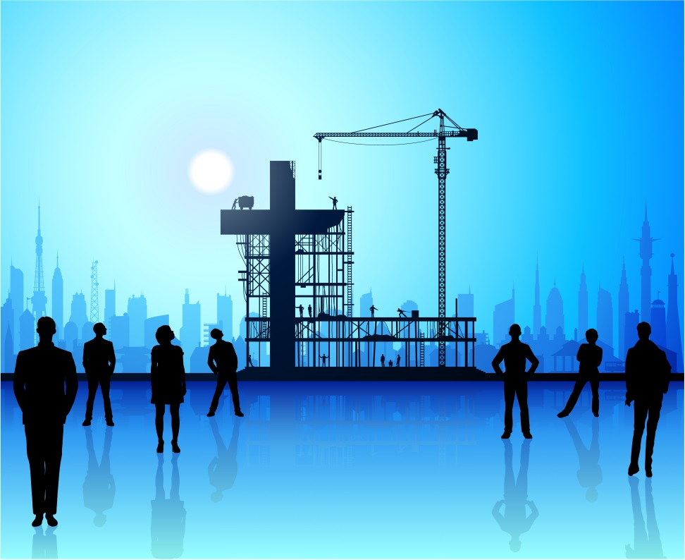
Becoming the Church God Builds
VIBRANT Church Renewal
Evangelism Ministries USA/Canada Region
Church of the Nazarene

Slide 2
Becoming the Church God Builds
The purpose of this module is to:
To encourage Christians to become the church God builds.
The objective for this module are:
Choose to declare God’s truth openly
Learn to differ with society purposefully and gently
Resolve to discern God’s voice continually.

Slide 3
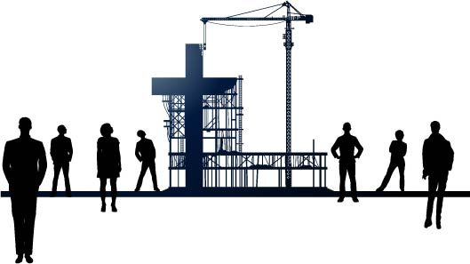
Becoming the Church God Builds
God grows churches through HUMAN leadership.
God CHOSE to build His church first on Peter (Matthew 16:18).
God realized Peter had WEAKNESSES.

Slide 4
Becoming the Church God Builds
Peter DEMONSTRATED a character change (Matthew 16:16, 18).
Simon was the fisherman who became a DISCIPLE (Matthew 4:18).
Simon was a “LEADER in the rough.”
The name Simon means “SANDY” with shifting allegiances.
Simon knew he NEEDED a character transformation (John 13:6-9).

Slide 5
Becoming the Church God Builds
Peter became a church BUILDER.
First, Simon made an OPEN confession of Christ (Matthew 16:16).
Then, Jesus blessed Simon with the new name of Peter, which means “ROCK” (Matthew 16:18).
Peter became a church leader AFTER he boldly confessed Christ.

Slide 6
Becoming the Church God Builds
God sees BEYOND our limitations.
God STILL selects people with weaknesses.
God saw Peter’s faults and yet recognized Peter’s STRENGTHS.
Let’s consider Peter’s strengths in light of our own POTENTIAL as people upon whom God wants to build His church.

Slide 7
Becoming the Church God Builds
Peter DECLARED the truth (Matthew 16:16).
Peter spoke INITIALLY.
Though Jesus’ question, “Who do you say I am?” was directed to ALL of the disciples, Peter was the first to respond (Matthew 16:15-16).
b. Peter did not seek VALIDATION from the other disciples.

Slide 8
Becoming the Church God Builds
Peter spoke PUBLICLY.
Peter spoke KNOWLEDGEABLY.
Peter IDENTIFIED who Jesus was when he said, “You are the Christ”.
Peter CLARIFIED who Christ was when he said, “You are the Son of the living God.”

Slide 9
Becoming the Church God Builds
Peter UNDERSTOOD the culture.
Peter IDENTIFIED three major beliefs about Jesus in his society (Matthew 16:14).
“Some say John the Baptist.”
“Others say Elijah.”
“And still others, Jeremiah or one of the prophets.”

Slide 10
Becoming the Church God Builds
Peter spoke in a CULTURAL context (Matthew 16:13); he understood what and how secular people thought.
Peter’s confession of Christ took place in the especially pagan region of Caesarea Philippi.

Slide 11
Becoming the Church God Builds
Peter DISCERNED God’s voice (Matthew 16:17).
Peter sought answers from the right SOURCE—Jesus.
Peter led the other disciples in QUESTION asking.
Peter asked for a parable explanation (Matthew 15:15).
Peter asked where Jesus was going (John 13:36).

Slide 12
Becoming the Church God Builds
Peter LISTENED for God’s voice (Matthew 16:16-17).
Peter learned to DISCRIMINATE between divine revelation and worldly opinion.
Peter did not SPEAK until he had heard from God.

Slide 13
Becoming the Church God Builds
God REVEALED Himself to Peter (Matthew 16:17).
God’s revelation gave Peter a personal BLESSING.
God’s revelation gave Peter a greater PURPOSE (Matthew 16:18).
Jesus COMMISSIONED Peter to build His church.

Slide 14
Becoming the Church God Builds
God CHOOSES to build His church on us (Matthew 16:18).
God does not build ALONE; He works through human leadership to build His church.
God promises Hades will not possess enough POWER to be successful against us, the church.

Slide 15
Becoming the Church God Builds
God gives keys to UNLOCK the kingdom.
Jesus first gave Peter the keys to unlock the kingdom for the Jews and Gentiles alike.
Jesus then gave the rest of His disciples the authority to unlock the kingdom.
Jesus grants us the authority to unlock the kingdom for the unsaved.
What we do on earth will have ETERNAL impact.

Slide 16
Becoming the Church God Builds
Today Jesus asks, “WHO will build my church?”
Disciples who speak INITIALLY with God to receive divine revelation.
Disciples who speak PURPOSEFULLY with unbelievers.
To discover belief systems.
To win unbelievers to the Lord.

Slide 17
Becoming the Church God Builds
Disciples who speak KNOWLEDGEABLY about their culture.
To compare and contrast secular beliefs with godly beliefs.
To bring unbelievers to the Lord.

Slide 18
Becoming the Church God Builds
Small Group Exercise
Answer the following questions in small groups of three to four people.
Identify some of the values in our society that bring people together.
What are reasons people come to worship in a local congregation for the first time?

Slide 19
Becoming the Church God Builds
Small Group Exercise Continued
Recently your coworker told you, “There is no hope for my marriage. We can’t possibly forgive each other after all the damage that’s been done.” As a Christian, how could you compassionately identify with your coworker’s personal hurt? Draft a sample conversation that communicates how God helps us forgive each other when we are hurt.
Now recall an actual conversation with a non-Christian in which you had an opportunity to constructively share the Gospel. In the space below, outline what you would say if you could have another discussion with that same non-Christian.

