Slide 1
Evangelism as Storytelling

Slide 2
Evangelism as Storytelling
The purpose of this module is:
To tell stories that convey good news to people
The objectives for this module are:
Grasp how God used stories;
Tell your stories and His;
Expand the number of stories you tell friends and family.

Slide 3
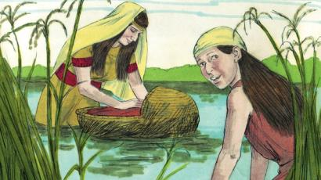
Evangelism as Storytelling
I. Our Family Stories Shape Us
God REVEALS Himself through stories.
The Old Testament recorded the life accounts of Adam and Eve, Noah’s family, Abraham and Sarah, Moses, Joshua, Daniel, David, and more.

Slide 4
Evangelism as Storytelling
The New Testament told the stories about Jesus—conflict with religious leaders about a single woman caught having sex; Nicodemus, a searching religious leader who admired Jesus; Jesus’ predictions of His own death and resurrection.
Jesus, the master storyteller, introduced the lost coin, lost sheep, and lost son—stories that point to a searching God (Luke 15).
Peter, Paul, and Stephen told stories and became stories told.

Slide 5
Evangelism as Storytelling
II. Personal Stories Can be Used
Tell of a prayer God answered.
Describe a time when you or someone you know experienced God’s healing.
Recall when God guided you to make a decision.
Recite a series of circumstances that point to God’s involvement.
Tell of influences that led you into God’s saving grace.

Slide 6
Small Group Discussion
1. Suppose you were to attach a theme or topic to the stories of the Old Testament characters. What would you write? For example: Joseph– The Man who Forgave
Adam and Eve-
Noah-
Abraham-
Moses-
Joshua-
Daniel-
David-

Slide 7
Small Group Discussion
How do these stories tell the Gospel—the Good News?
What occasions can you imagine yourself telling one of these stories?
List some more stories Jesus told.
How are they evangelistic?
What do they tell us about God?
How do these stories invite a response to God?

Slide 8
Action Planning/Reporting
What stories might you tell a person who is sick or who has been in an accident?
What stories would connect with a person whose faith is faltering?
What stories (biblical or personal) could spark hope in another’s heart?
Who do you know that would respond to a story you tell?

