Slide 1
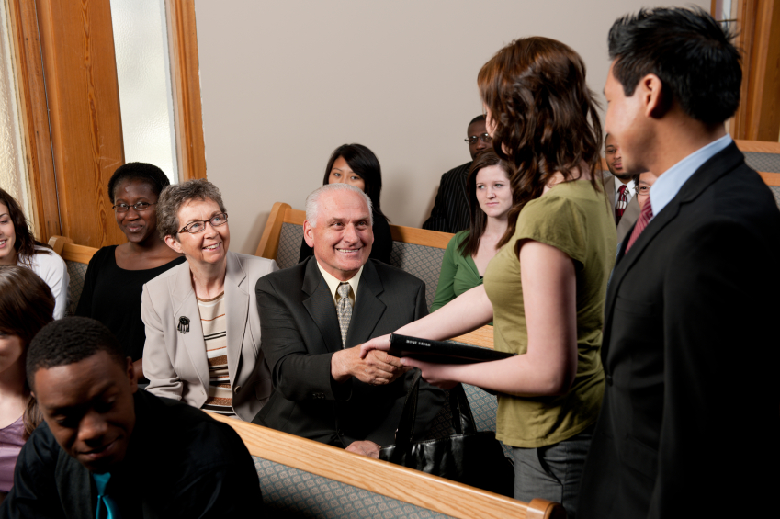
Welcoming Newcomers
Into Fellowship
Church Renewal Resource
Evangelism Ministries USA/Canada Region
Church of the Nazarene

Slide 2
Welcoming Newcomers Into Fellowship
The purpose of this module is to encourage the church to love people into fellowship.
The objectives for this module are:
  To recognize the human need for belonging.
  To identify the obstacles that prevent us from freely loving newcomers into the fellowship of the church.
  To strategize ways to improve biblical hospitality in our church.

Slide 3
Welcoming Newcomers Into Fellowship
Introduction
  Acts 9:26-28
  “When he came to Jerusalem, he tried to join the disciples, but they were all afraid of him, not believing that he really was a disciple. But Barnabas took him and brought him to the apostles. He told them how Saul, on his journey, had seen the Lord and that the Lord had spoken to him, and how in Damascus he had preached fearlessly in the name of Jesus. So Saul stayed with them and moved about freely in Jerusalem, speaking boldly in the name of the Lord.”

Slide 4
Welcoming Newcomers Into Fellowship
To bring Saul of Tarsus into the fellowship of the church was no simple assimilation task. He was a feared Jew who was known throughout Palestine for persecuting the followers of Jesus.
His conversion to Christ made little impact on the willingness of the Christians to open their arms to him.
“Barnabas,” the Scripture says, “took him….” Barnabas loved enough to risk bringing Saul into the fellowship of the church.

Slide 5
Welcoming Newcomers Into Fellowship
Research shows:
  If people, who attend church for a month, don’t make four friends, they will not return.
  Visitors make up their minds whether they will come back to our church in the first eleven minutes.
  Newcomers to town will try to find a church that will treat them like their home church treated them. If they do not find what they are looking for within six weeks, they will not return to church for ten years.

Slide 6
Welcoming Newcomers Into Fellowship
What is it that helps newcomers remain in a church?
  An answer to that question might be biblical hospitality.
  Biblical hospitality communicates love and acceptance to all strangers.
Welcome!

Slide 7
Welcoming Newcomers Into Fellowship
II. If our church is to become effective in meeting the needs of worshipers, we must know:
  We are called to meet the human need for belonging.
    We will inevitably face obstacles in loving newcomers into the fellowship.
    We can improve in the area of biblical hospitality within our church.
    Churches tend to be inclusive in evangelism but exclusive in relationships.

Slide 8
Welcoming Newcomers Into Fellowship
Most churches recognize God’s call to reach all mankind with the Gospel (John 3:16; 2 Peter 3:9).
While they might desire everyone to come to faith in Christ, some congregations will not open their friendship circles to the new Christian.
Christ was radically inclusive in relationships and was criticized because of it.

Slide 9
Welcoming Newcomers Into Fellowship
“After this, Jesus went out and saw a tax collector by the name of Levi sitting at his tax booth. “Follow me," Jesus said to him, and Levi got up, left everything and followed him. Then Levi held a great banquet for Jesus at his house, and a large crowd of tax collectors and others were eating with them.
“But the Pharisees and the teachers of the law who belonged to their sect complained to his disciples, "Why do you eat and drink with tax collectors and 'sinners'?
“Jesus answered them, "It is not the healthy who need a doctor, but the sick. I have not come to call the righteous, but sinners to repentance" (Luke 5:27-32).

Slide 10
Welcoming Newcomers Into Fellowship
The people, by whom the Pharisees were repulsed, were the same people to whom Jesus was attracted.
While the Pharisees thought the tax collector would make Jesus dirty, Jesus made the tax collector clean.
Jesus spent time relationally with these “sinners” before they became disciples.

Slide 11
Welcoming Newcomers Into Fellowship
When a person accepts Jesus, he enters community theologically and hopefully socially.
Three metaphors describe this community of believers:
  The body of Christ.
    Each and every Christian is a part of the body of Christ.
    Each person has his/her special purpose within the body.

Slide 12

Welcoming Newcomers Into Fellowship
“Now you are the body of Christ, and each one of you is a part of it. And in the church God has appointed first of all apostles …”
(1 Corinthians 12:27-28a).

Slide 13
Welcoming Newcomers Into Fellowship
A part of the house
  “But Christ is faithful as a son over God's house. And we are his house, if we hold on to our courage and the hope of which we boast” (Hebrews 3:6).
  The Christian church represents the house of God.
  Each member represents a stone in that house.
  Christ is continually building this house (Matthew 16:18).

Slide 14
Welcoming Newcomers Into Fellowship
A member of the family
“Yet to all who received him, to those who believed in his name, he gave the right to become children of God” (John 1:12).
  Receiving Jesus makes one a part of God’s family.
  We are brothers and sisters in Christ.

Slide 15
Welcoming Newcomers Into Fellowship
We are to bring people into the life, fellowship, and ministry of the church.
We must spend time and energy with new people.
  New people are seeking relationships.
  People are not as interested in a friendly church as much as a church where they can have friends.
  Twenty-three times in the New Testament epistles, the authors refer to the recipients of the letter as “friends”.

Slide 16
Welcoming Newcomers Into Fellowship
8. We are to create a climate of love.
  In I John 3-4, John encourages fellow believers five times to “love one another.”
  Love is the central characteristic of the Christian individual (1 Corinthians 13:13).
  With love comes patience, kindness, protection, trust, hope, and perseverance (1 Corinthians 13:4-7)—qualities needed with newcomers.

Slide 17
Welcoming Newcomers Into Fellowship
We face a number of obstacles in loving newcomers into the fellowship.
  Resistant family networks
    Many family networks within the church are controlling and do not allow for others to become fully assimilated into the life and ministry of the local church.
    Family networks generally resist change.

Slide 18
Welcoming Newcomers Into Fellowship
Traditions may be comfortable to us but unfamiliar to others.
  Many newcomers feel that the church speaks a different language.
  Sometimes traditions evolve into rules, and rules without reason are difficult for newcomers to understand.
  Tradition without feeling is unacceptable to most newcomers.

Slide 19
Welcoming Newcomers Into Fellowship
Strife, friction, or diversity
  At times the highly committed volunteers of the church feel a level of burnout and complain that no one helps, while at the same time, others are frustrated they cannot be more involved.
  Conflict ended by consensus.
  Differences of opinion do not divide churches; attitudes stunt the growth of the congregation.

Slide 20
Welcoming Newcomers Into Fellowship
“Some men came down from Judea to Antioch and were teaching the brothers: ‘Unless you are circumcised, according to the custom taught by Moses, you cannot be saved.’ This brought Paul and Barnabas into sharp dispute and debate with them. So Paul and Barnabas were appointed, along with some other believers, to go up to Jerusalem to see the apostles and elders about this question. “James spoke up…‘It is my judgment, therefore, that we should not make it difficult for the Gentiles who are turning to God’” (Acts 15:1-2, 19, 28-29).
“It seemed good to the Holy Spirit and to us not to burden you with anything beyond the following requirements: You are to abstain from food sacrificed to idols, from blood, from the meat of strangled animals and from sexual immorality. You will do well to avoid these things. Farewell” (Acts 15:28-29).

Slide 21

Welcoming Newcomers Into Fellowship
We should let Scripture be our final guide in disputed matters.
When disputing matters of doctrine, love should prevail.

Slide 22
Welcoming Newcomers Into Fellowship
A no-growth attitude can be heard in a number of comments:
  “Our church is big enough already.”
  “I don’t want our church to get too much bigger.”
  “We already can’t keep up with the people we have attending.”
  “I want to do outreach as much as anyone, but what about us?”

Slide 23
Welcoming Newcomers Into Fellowship
Differences among people
  Economic, ethnic, and educational differences can be obstacles to assimilation.
  Sunday morning has been called the most segregated hour in the week.
  People tend to gravitate to others who are similar to them.

Slide 24
Welcoming Newcomers Into Fellowship
C. We can improve our ministry.
  1. Identify newcomers in non-threatening ways.
    The church must walk a tightrope between being overbearing to a newcomer on one side and appearing cold and callused on the other.
    Newcomers generally don’t like to be singled out in a crowd.
    Newcomers tend to want to be anonymous to the whole, but known on the individual level.
    Be friendly, but not overbearing.
    Greet newcomers, but don’t corner them.

Slide 25
Welcoming Newcomers Into Fellowship
2. Look at our church through the eyes of the first-time visitor.
3. Welcome newcomers before greeting our friends.
  Practice the Five-Person Rule.
  After worship services, attempt to have a friendly conversation with five people you don’t know or don’t know well before you go to your friends.

Slide 26
Welcoming Newcomers Into Fellowship
Help new worshippers find a group and start new groups as often as possible.
  A small group is any group that…
    Less than 15 in attendance.
    Meets on a regular basis – at least once per month.
    Creates a sense of caring – people are missed and contacted if they are not there.

Slide 27
Welcoming Newcomers Into Fellowship
b. Small groups provide a place for individuals to…
  Be open and vulnerable in a safe environment.
  Learn and grow.
  Gain support during life’s difficult times.

Slide 28

Welcoming Newcomers Into Fellowship
Small Group Exercise
  Identify the areas of our church that enable people to be assimilated into the church. In what areas do we do well?
  What in our church hinders people from being loved into the fellowship? What area of improvement do we need to concentrate on most?
  What fears would you identify as being associated with numerical growth of a local church? Why do new people bring fear to established members?

Slide 29
Welcoming Newcomers Into Fellowship
Action Planning/Reporting
  Since people enjoy participating, who new to our church could be invited to serve on a committee, worship team or discipleship class?
  How do we address the fears our established people have?
  Who needs us to phone and to encourage them? How can we assure this personal interest in others is sustained?

