Slide 1

Resolving
Conflict

Slide 2

Resolving Conflict
PURPOSE
  Create a climate in which church leadership can deal appropriately with conflict.

Slide 3
Resolving Conflict
OBJECTIVES
  Identify the sources of church conflict.
  Develop processes by which to address issues present in a local church.
  Suggest skills profitable for conflict reduction.

Slide 4
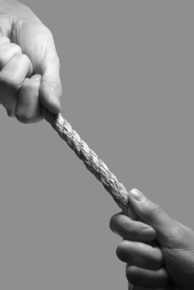
Resolving Conflict
“If a man is overtaken in any trespass, you who are spiritual should restore him in a spirit of GENTLENESS” (Galatians 6:1).
“We have renounced disgraceful underhanded ways; we REFUSE to practice cunning (II Corinthians 4:2).

Slide 5
Resolving Conflict
“The weapons for our warfare are not WORLDLY” (II Corinthians 10:4).
“Be subject to one another out of reverence for CHRIST” (Ephesians 5:21).

Slide 6
Resolving Conflict
“Then let us no more pass JUDGMENT on one another…let us then pursue what makes for peace and mutual up building”(Romans 14:13,19).

Slide 7
Resolving Conflict
“If anyone REFUSES to obey what we say in this letter, note that man and have nothing to do with him, that he may be ashamed” (II Thessalonians 3:14).

Slide 8
Resolving Conflict
“Do not look on him as an enemy, but WARN him as a brother” (II Thessalonians 3:15).
“Finally, brethren, farewell. Mend your ways, heed my appeal, AGREE with one another, live in peace, and the God of love and peace with be with you” (II Corinthians 13:11).

Slide 9
Resolving Conflict
Do not REBUKE an older man, but exhort him as you would a father, treat younger men like bothers, older women like mothers, younger women like sisters, in all purity” (I Timothy 5:1-2).

Slide 10
Resolving Conflict
The scripture makes clear that we are to do every thing we can to keep conflict down, but we are not to AVOID confrontation if it is principle-oriented. The problem is: we can find scripture to support our position if we are being ATTACKED or wanting to do the attacking.

Slide 11
Resolving Conflict
A healthy emotional person and an objective leader will accurately DETERMINE what scripture applies when.

Slide 12
Resolving Conflict
Conflict isn’t always bad or HARMFUL.
Conflict HAPPENS even if you have no interest in what the other party wants.
Conflict can start from MINOR issues and become a major issue.
Conflict may be INHERENT in your job description as a leader.
Conflict may occur with someone you LIKE or dislike.
If we do not deal with conflict within twenty-four hours, there is only a two percent chance the conflict will ever be dealt with successfully.

Slide 13
Resolving Conflict
WITHDRAWER
Takes LEAVE/LOSE approach. A withdrawer believes in “walk away power”. He/She will avoid conflict even though they may lose something important.

Slide 14
Resolving Conflict
DOMINATORS
Take the WIN/LOSE approach. Dominators operate as though they have the right and the power on their side.

Slide 15
Resolving Conflict
PLACATORS
Take the YIELD/LOSE approach. A placators will do about anything to maintain the relationship.

Slide 16
Resolving Conflict
COMPROMISERS
Take the MINI-WIN/MINI-LOSE approach. Compromisers believe both parties have something to give and something to take. Compromisers are convinced that both individuals are partially right.

Slide 17
Resolving Conflict
COLLABORATORS
Take the WIN/WIN approach. Collaborators do whatever it takes to get the job done and maintain relationships at the same time.

Slide 18
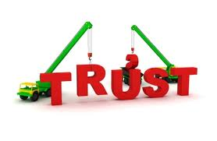
Resolving Conflict
Keys to Conflict Reduction
BUILD trust
Conflict will SUBSIDE in direct relationship to the amount of trust built.
AFFIRMING one another with the church is a means of building trust.
Trust is needed in the church second only to what is needed in the home.

Slide 19
Resolving Conflict
Where people genuinely LOVE each other, trust flourishes.
ACCEPTANCE of each other promotes trust, too.
When we ADMIT to our humanness, people are more apt to generate confidence in us.
Encouragement is a means of building up trust as well. “You were there when I needed you,” (pastoral care) HEIGHTENS the trust factor.

Slide 20
Resolving Conflict
Integrity of life GENERATES trust.
Broken confidence DESTROYS trust.
Ridicule LOWERS the trust level.
BROKEN promises wipe out the confidence factor.
Conflict does not divide us, but LACK of trust does.

Slide 21
Resolving Conflict
GIVE Grace
The following is from Conflict and Caring by Keith Huttenlocker:
Ethics, as well as grace, suggest to pastors that they do any or all of the following during conflict.
Calmly ACCEPT the chastisement of the people
PROFIT wisely from all warranted criticism, regardless of its origin or manner of presentation.

Slide 22
Resolving Conflict
Openly REPENT of any wrong or foolishness.
Freely FORGIVE those who have trespassed against the pastor and treat them as forgiven.
VOLUNTARILY make the requested changes that are not unscriptural or otherwise irresponsible (i.e. harmful to others).
Preach and PRACTICE love toward all.
Remain an example of COMPOSURE and integrity in all situations.

Slide 23
Resolving Conflict
Speak and write POSITIVELY when addressing the congregation and the outside community.
DEEPEN a personal walk with Jesus Christ.
LIMIT authority to that granted by the church bylaws, resisting all temptations to invoke “marshal law.”

Slide 24
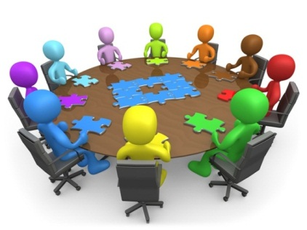
Resolving Conflict
Small Group Activity
Read “When the Leaders Leave” case study
What are the best steps to take to solve this case?
What criteria would influence your decision making?

