Slide 1
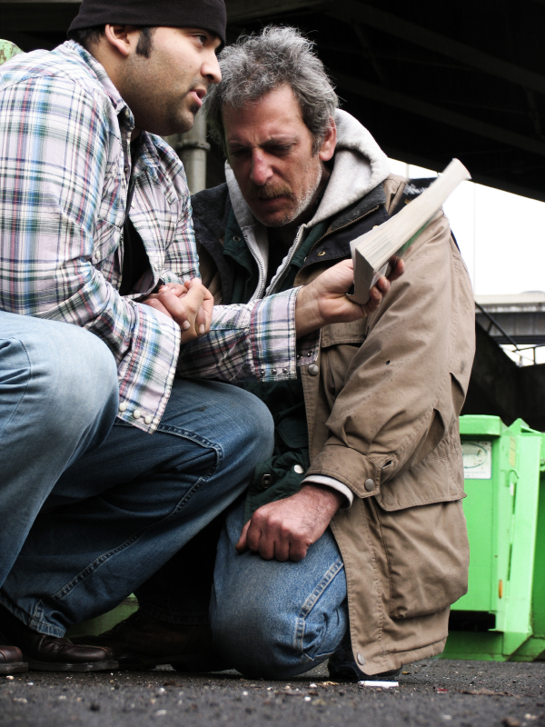
Developing a Passion for the Unchurched
Church Renewal Resource
Evangelism Ministries USA/Canada Region
Church of the Nazarene

Slide 2
Developing a Passion for the Unchurched
The purpose of this module is to
help us discover practical steps to increase our passion for the unchurched.
The objective for this module are:
  To share practical steps to increase our own passion for those who are away from Christ and His Church.

Slide 3
Developing a Passion for the Unchurched
A. We can move closer to our Master.
  If we get too far away from our Lord Jesus and the fire of our commitment cools.
  Losing that warmth, we contribute little toward the mission of winning those who don’t yet know Jesus.

Slide 4
Developing a Passion for the Unchurched
  In our cooled-off condition, (the Lord calls it “luke-warmness,” Revelation 3:16), we just don’t focus on the mission.
  Most often, our vision goes no further than our own INTERESTS.
Instead of focusing on ourselves, we start feeling COMPASSION for those apart from Christ and begin to genuinely care about them.

Slide 5
Developing a Passion for the Unchurched
We can understand the difference between “FIRE-LIGHTERS” and “firelighters.”
  “FIRE-LIGHTERS” are those people who tend to extinguish the flames of our passion.
    They are the critics, the COMPLAINERS.
    They are the NEGATIVE people who can never see anything good.
    They are the FAULT-FINDERS whose fingers are quickly pointed at the flaws of those around them.

Slide 6

Developing a Passion for the Unchurched
On the other hand, “FIRE-LIGHTERS” fan the flames of godly passion in our heart.
  They are the ENCOURAGERS, the helpers, the cooperative supporters whose actions and words of appreciation inspire us to move ahead.

Slide 7
Developing a Passion for the Unchurched
  Their WILLINGNESS to see the good in us lifts our spirits. Their “thank yous” brightens our day.
  Spend time around “fire-lighters” and we discover we are better than we thought! Our COMMITMENT is warmed by their enthusiasm and encouragement.

Slide 8
Developing a Passion for the Unchurched
We need those who believe in us, who encourage, challenge and INSPIRE us to accomplish more than we would otherwise attempt.
To raise the temperature of our PASSION for the unchurched, find encouragers, people who will support and lift you.
Hang around people who will say by their words and actions.

Slide 9
Developing a Passion for the Unchurched
We can learn about passionate people and let their examples inspire us.
FOCUS. “People with a purpose.”
  Passionate people possess a clear, single-minded vision that inspires and PROPELS them to accomplish more than expected.
  Passion makes ordinary people EXTRAORDINARY

Slide 10

Developing a Passion for the Unchurched
PASSION makes a difference. We can lift the level of our passion.
  We can move closer to our Lord. When we do, the fire of His LOVE for humankind will fill us.
  We can find people who BELIEVE in us. We can surround ourselves with “fire-lighters.”

Slide 11
Developing a Passion for the Unchurched
We can learn not to allow their negativity to control our mind and heart.
We can use the inspiration that comes from passionate people to encourage, guide and lift us.
There are things we can do to ignite a passion for the lost in our own heart.
Our passion will make a difference.

Slide 12

Developing a Passion for the Unchurched
Describe enthusiastic people. Who do you know who understands or enjoys unbelievers?
What might they tell you if you asked them the source of their passion?
Which of their behaviors and attitudes can you adapt?

