Slide 1
Communicating Vision
VIBRANT Church Renewal
Evangelism Ministries USA/Canada Region
Church of the Nazarene

Slide 2
Becoming the Church God Builds
The purpose of this module is to:
To inspire pastor and people to see God’s design for the local church.
The objectives for this module are:
Discuss Christ’s vision for His world.
Identify myths and realities about vision.
Evaluate the local church’s accomplishments and plans.

Slide 3
Communicating Vision
Most of us know what we should do, but sometimes fail to act. What is missing?
Why do we busy ourselves with things of lesser significance? Students of human behavior tell us the difference is VISION! Vision helps us create energy and momentum. Joel prophesied, “Your old men will dream dreams and your young men will see visions!”

Slide 4
Communicating Vision
A large vision produces a large MOTIVATION.
We may be caught up in the trap of living as a Christian rather than KNOWING and following God’s design for our lives.
This is true particularly when we begin to set spiritual and behavior goals which are impossible in our own strength. Yet these dreams fill us with EXCITEMENT as we think about the possibility of achieving what God plans for us—individually and as a church.

Slide 5
Communicating Vision
Capturing the vision of our Lord works a lot like our eyesight. The CLOSER we get to Him, the clearer the image becomes. Who knows, He may have things in mind that go beyond your fondest desires for your church. His purpose is that none would perish, but that all would come to the knowledge of His saving grace.

Slide 6
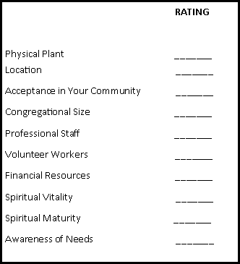
Communicating Vision
Small Group Exercise
TODAY
Give yourself a score from 0 to 10 in each of these categories. 0 means you and your church had nothing going in this area, and 10 means you were absolutely living to the highest desire of Christ in this area.

Slide 7
Communicating Vision
TRADITION KILLS VISION
“We have never done it that way before!”
FEAR KILLS VISION
Few Christians possess the spiritual maturity to release control of their lives and allow God to rule daily.
PREFERENCES KILL VISION
What style of music is most popular with the people God wants to reach? Is that your style of church music? What is the role of women in your community? Do they have similar roles in your church?

Slide 8
Communicating Vision
COMPLACENCY KILLS VISION
Jesus was passionate about those who did not know God.
FATIGUE KILLS VISION
So get the rest you need on a regular basis.
Short-Term THINKING KILLS VISION
God’s timing is different from ours. He is not pressured by time, but His timing is perfect.

Slide 9
Communicating Vision
Vision should be the result of a consensus among the church’s key leaders regarding future activity by the church.
REALITY: Vision is not the result of consensus; it should RESULT in consensus.
Vision and mission are synonymous.
REALITY: While vision relates to specific ACTIONS, mission relates to general approaches to action.
Some leaders are visionaries, some aren’t.
REALITY: By definition, all leaders are visionaries. A godly leader is one who OPERATES from a base of God’s vision for his or her ministry.

Slide 10
Communicating Vision
The purpose of vision is to estimate future realities, then to operate effectively within those parameters.
REALITY: The purpose of vision is to CREATE the future. God has chosen you to exert control for Him over your environment!
The goal of vision for church ministry is numerical growth.
REALITY: The absolute goal of vision for ministry is to GLORIFY God and bring all people everywhere to glorify God.

Slide 11
Communicating Vision
As long as the senior pastor has a sense of vision, it doesn’t matter whether the people really know or understand it. They will be swept along by the force of the vision, regardless.
REALITY: Vision has no force, power, or impact unless it SPREADS from the visionary to the visionless.
Because of the breadth and challenge that is reflected by God’s vision for ministry, vision is likely to make the laity fearful, skeptical, and anxious.
REALITY: Vision, when properly ARTICULATED, does not make people afraid nor doubtful.

Slide 12
Communicating Vision
If it is truly God’s vision for ministry, capturing that vision will be a simple, quick process.
REALITY: God’s vision is not CONSTRAINED by time.
To develop vision, a pastor could identify several visionary business leaders and follow the same steps they have taken.
REALITY: Church leaders cannot blindly follow the path CHARTED by people who operate on the basis of a different world view.

Slide 13
Communicating Vision
Because vision is imparted by God to the pastor, other people have no role in the development of vision, only in its implementation.
REALITY: Other godly individuals are needed as a sounding board to EVALUATE the vision at various points in its development.
Sometimes God’s vision for the future of a struggling congregation simply calls for the church to stabilize by maintaining its current position rather than to pursue growth aggressively.
REALITY: Encouraging people to pledge themselves to SURVIVAL is an admission of defeat.
A church’s vision needs to be re-created every couple of years.
REALITY: Vision usually OUTLASTS the visionary.

Slide 14
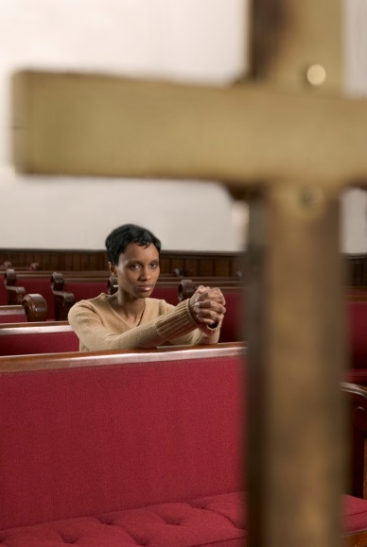
Communicating Vision
If a pastor simply loves the Lord and does the things described in the Bible as the qualities of a good leader—teaching, preaching, praying, modeling forgiveness and love, and so forth—the church will grow, vision or no vision.
REALITY: Effective leaders must be VISIONARIES.

Slide 15
Communicating Vision
If our vision is for transformed pilgrims in the community of believers, then both our method and our context are MEANS not ENDS in themselves.
VISION
CONTEXT
METHOD

Slide 16
Communicating Vision
The homework assignment for this module (below) is:
Complete the following questions about context, vision, and method.
As a group, discuss your findings.

Slide 17
Communicating Vision
Action Planning/Reporting
Context – WHERE ARE WE? (This is the information identified during the small group exercise.)
What are the needs, the problems, the opportunities we face?
Who are our students, our teachers, our professional staff, and what are their spiritual gifts and natural abilities?
What resources of time, money, building, and location has God enabled us to have?

Slide 18
Communicating Vision
Action Planning/Reporting
Vision – WHERE ARE WE GOING?
If God blesses this church and we do the very things Christ came to do when He came to earth, how will we see our congregation, community, our ministry, and our world?
If Jesus came to OUR TOWN, what would he be doing?
Could His vision become our vision?

Slide 19
Communicating Vision
Action Planning/Reporting
Method – HOW DO WE GET THERE?
What should I teach?
How should I teach?
What can I do to proclaim salvation to our community?
How would Christ seek and save my lost husband or child?
Who will I report progress to and will I be honest about frustration and failure?
How can our church become the real BODY OF CHRIST in our community?

