Slide 1
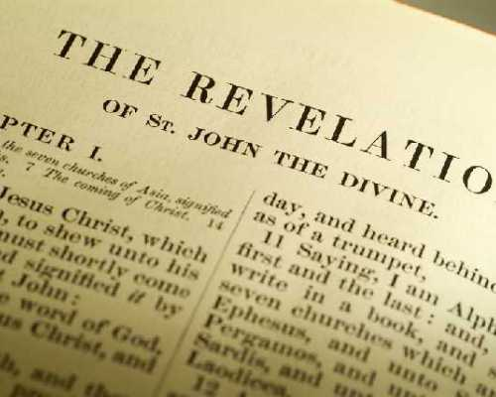
Ancient Evangelism Now
Church Renewal Resource
Evangelism Ministries USA/Canada Region Church of the Nazarene

Slide 2
Ancient Evangelism Now
The purpose of this module is to view your congregation from God’s perspective in order to make the appropriate changes that would please Him.

Slide 3
Ancient Evangelism Now
The objectives are to:
Identify congregational strengths and affirm God’s ministry among us;
Admit to weaknesses preventing God freedom to use His people for outreach;
Ask God to refresh our people by His Spirit and to pursue God’s mission for our congregation.

Slide 4
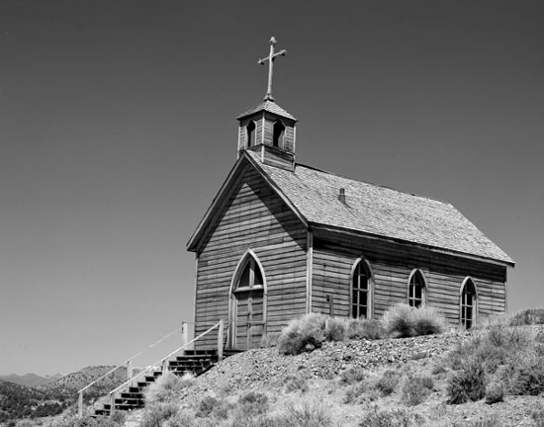
Ancient Evangelism Now
The seven churches in Revelation 2-3 needed RENEWAL.
God knows these churches and CONCLUDES they must make some changes.

Slide 5
Ancient Evangelism Now
A PATTERN appears in these two chapters that God uses to bring renewal:
Commendation—God AFFIRMS the strengths of the congregation.
Correction—God NOTES the changes needed.
Challenge—God DIRECTS the churches’ attention to what they must do.

Slide 6
Ancient Evangelism Now
Revelation 3:14-22- Jesus IDENTIFIES Himself as the Amen—the One who tells the truth.
He is a FAITHFUL and true witness.
He is also the RULER of God’s creation.

Slide 7
Ancient Evangelism Now
When Jesus ADDRESSES the church at Laodicea, He omits any words of commendation.
No mention is made of heretical influence.
The HEART problem is far more serious than correct thinking.

Slide 8
Ancient Evangelism Now
The Laodicean church (15-16) includes spiritual MEDIOCRITY; neither hot nor cold.
Jesus REBUKES them saying, “I am about to spit you out of my mouth” (17).
The church’s attitude is ARROGANT, “I am rich and do not need anything.”
Jesus says, “But you do not realize that you are wretched, pitiful, poor, blind and naked.”

Slide 9
Ancient Evangelism Now
Because Jesus loves them He DISCIPLINES them (19).
He CALLS for them to repent (19).
He INVITES them into fellowship (20).
He PROMISES victorious people the right to sit with Him on His throne (21).
Then Jesus SUGGESTS the congregation listen to the Spirit (22).

Slide 10
Ancient Evangelism Now
Small Group Discussion
Discuss the following questions in your small group.
What strengths present in the churches of Revelation are active in your congregation?
What concerns can you identify in your church?
For what would God ask you to repent?
How does a congregation repent?
For what promises of God to the Revelation churches would you pray?
How does a congregation listen to the Spirit?

Slide 11
Ancient Evangelism Now
Action Planning/Reporting
Conduct an eight week course on the seven churches. (A free curriculum resource can be found at http://usacanadaregion.org/renewal-articles.)
Take identified concerns in your local congregation to the church board.
Ask the leadership team to prayerfully consider what to do to improve your church.
Invite people to listen to what the Spirit is saying to the church.

Slide 12
Ancient Evangelism Now
Thank you for participating in this program from USA/Canada Evangelism Ministries.
For more information, find us online at http://www.usacanadaregion.org/training-modules

